Slide 1
Introduction to Image Analysis with FIJI
1. Introduction, Basic Concepts, Counting Objects
Gayathri Nadar, Noreen Walker
Scientific Computing Facility, MPI-CBG
3.-7.5.2021
Topics:
Introduction to Image Analysis
What is an image
Introduction to FIJI
ROI and measurements
Counting objects (spot detection)
With material from:
Robert Haase
Benoit Lombardot

Slide 2
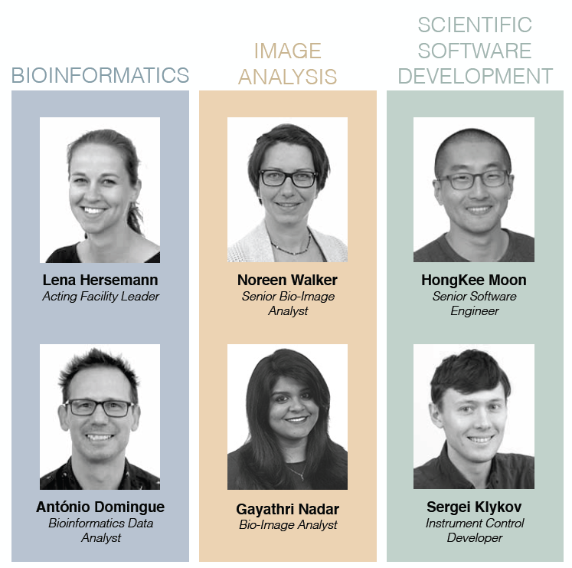
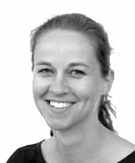

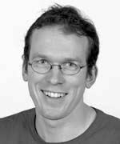
Who are we?
“The Scientific Computing Facility aims to provide a unified service to assist researchers in the tackling of scientific questions involving computational analysis, large data handling and image processing.”
RESEARCH DATA MANAGEMENT
& ELN SUPPORT
FACILITY LEADER
Lena Hersemann
Facility Leader
Stephan Janosch
Research Software Engineer
André Gohr
Bioinformatician
Joining in 2021
Bioinformatics Data Analyst
Notes:
Bio Image informatics service is embedded in the SCF:
Together with bioInformatics and Scientific software development

Slide 3
Course Overview
Day 1 (Mon 3.5.)
Image basics, visualization, measurements
Spot detection
Segmentation (start)
Day 2 (Tue 4.5.)
Visit LMF
Segmentation (cont’d)
Mathematical background: image filters, morphology
Day 3 (Wed 5.5.)
Advanced segmentation: Machine learning with Ilastik
IJ Macro (start)
Day 4 (Thu 6.5.)
IJ Macro (cont’d)
3D data: visualization and analysis
Day 5 (Fri 7.5.)
Image registration, image stitching
Time sequence analysis and tracking
Good practices
Notes:
Course structure: afternoon session with 1 break in between
Slides + Demo + independent Exercises

Slide 4
Overview
What is image analysis?
What is an image?
Tools for image analysis
Introduction to FIJI: image characteristics and visualization
ROIs and measurements
Counting objects: maxima detection
Notes:
Overview course structure: presentations, demos (hands-on), and DIY exercises
Red and green post-its

Slide 5
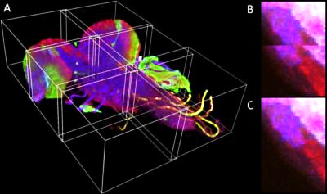
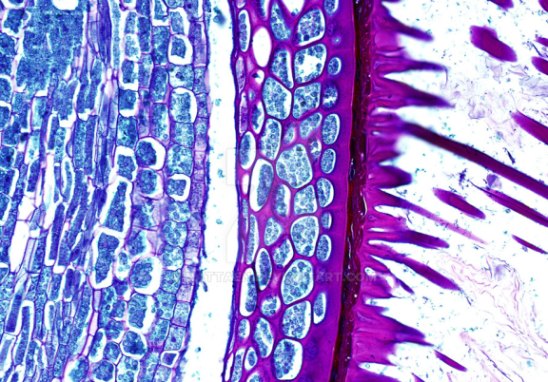
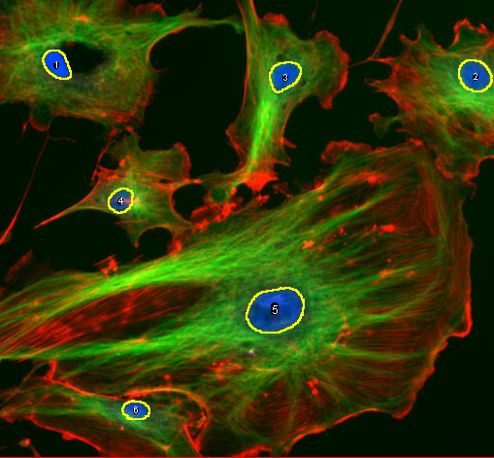
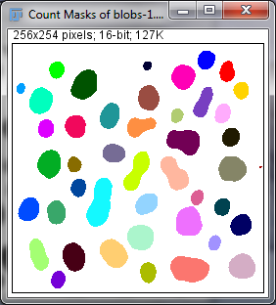
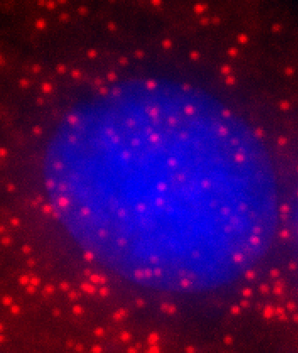
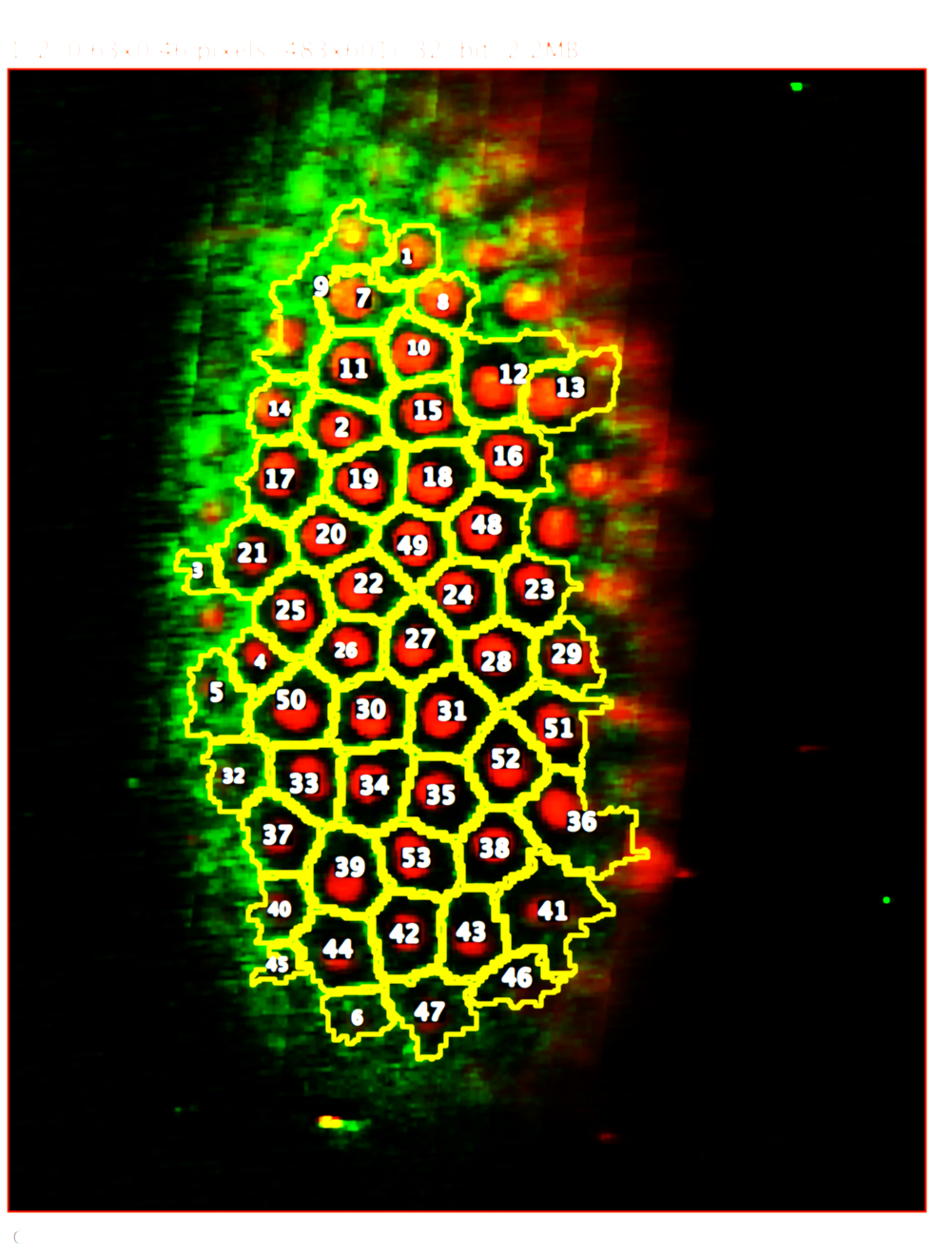
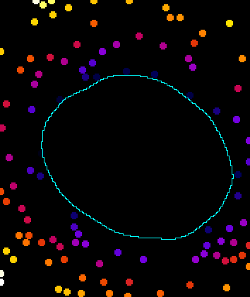
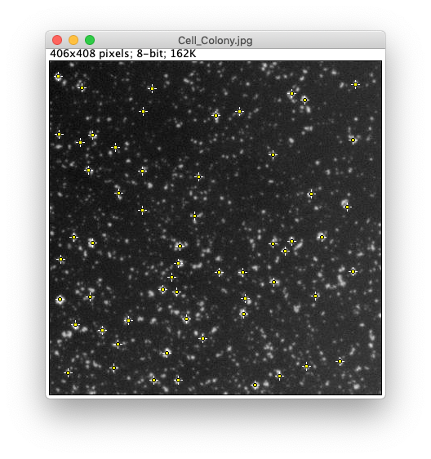
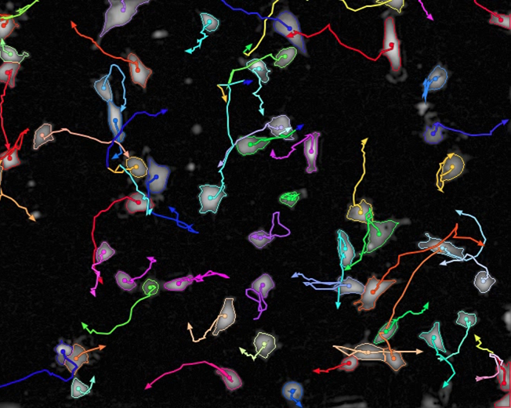
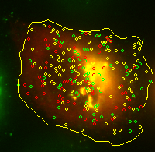
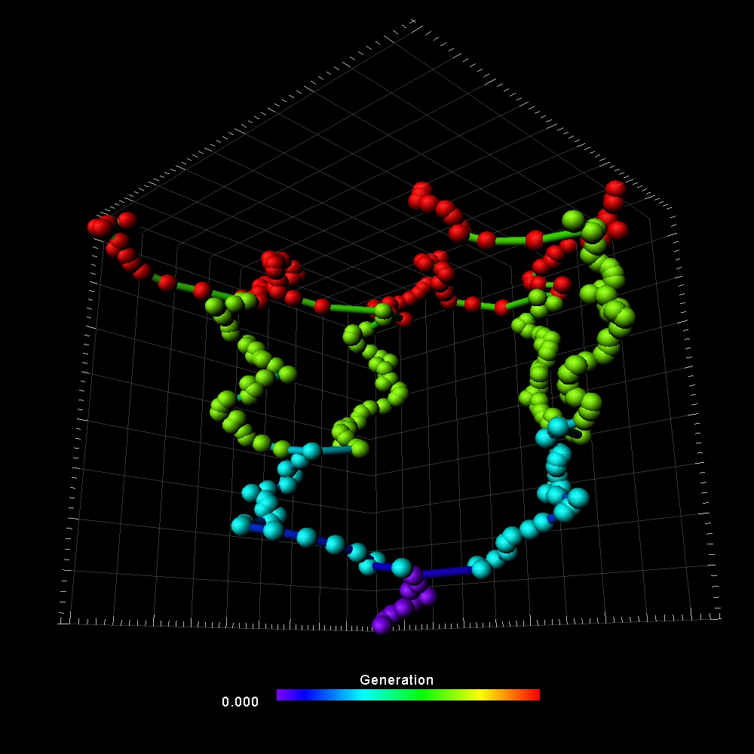
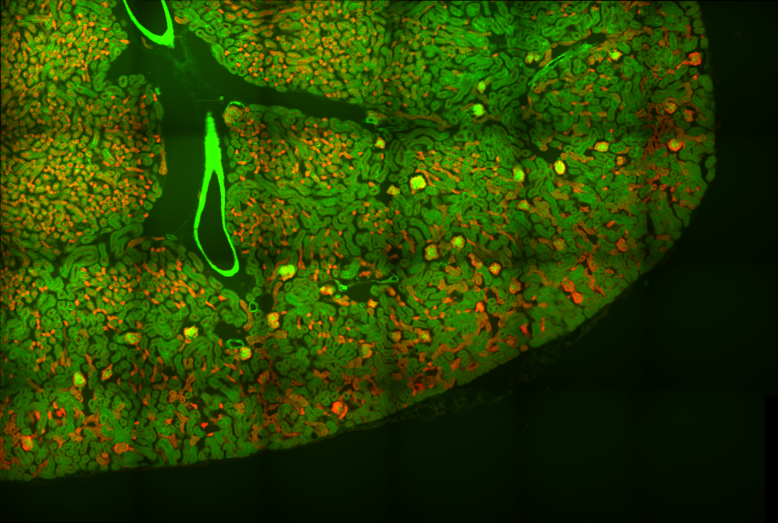
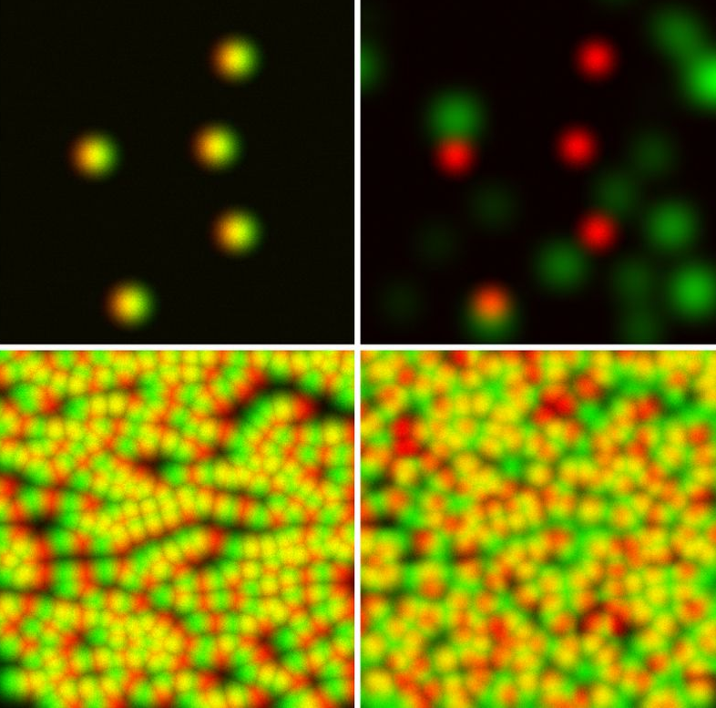
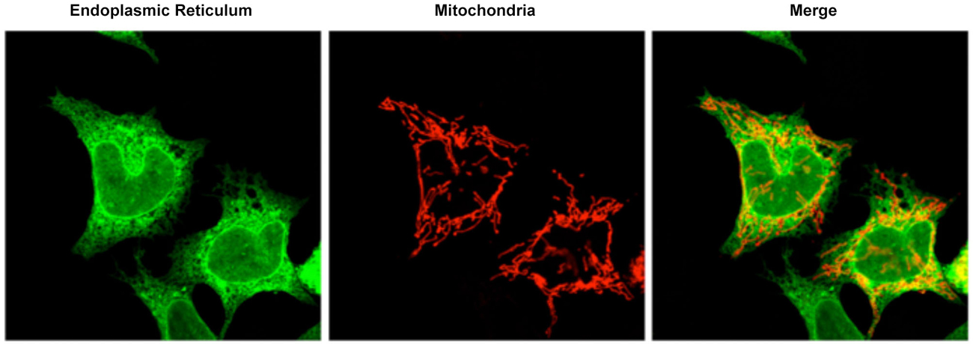
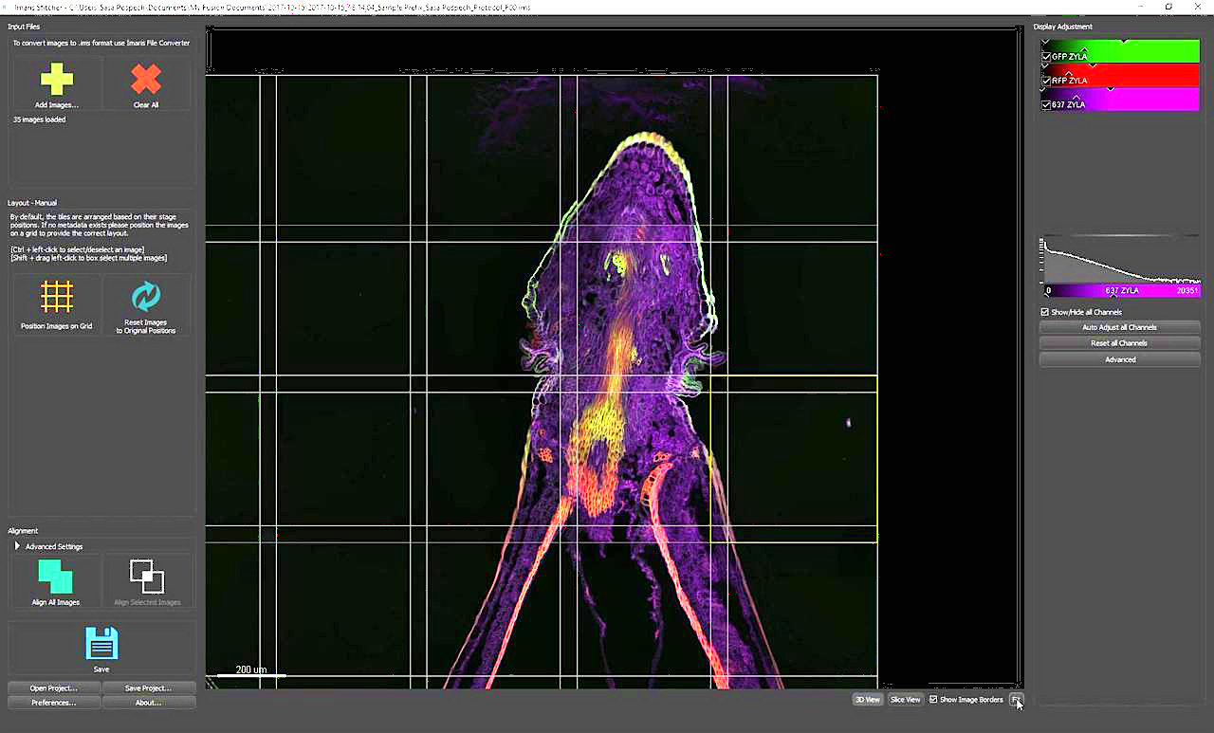
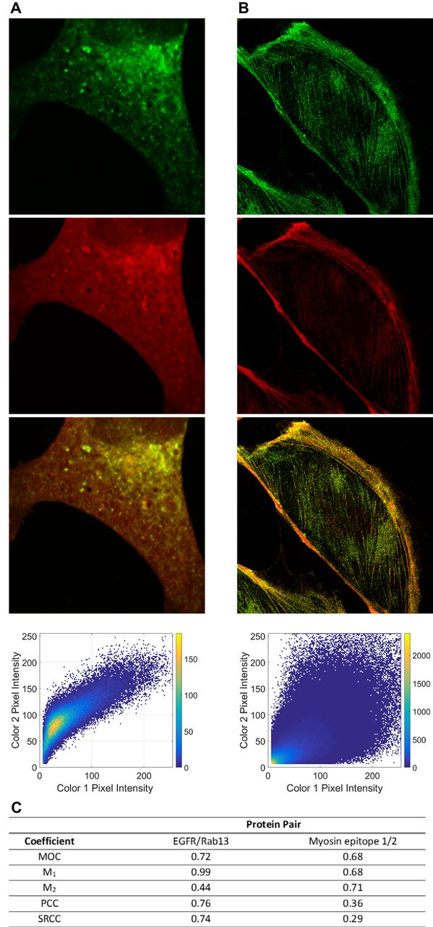
What is Bio-Image Analysis?
Image Correction
Segmentation
Spot detection
Bio-Image analysis
Tracking
Stitching
Colocalization

Slide 6
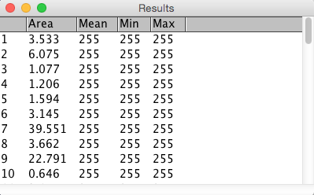
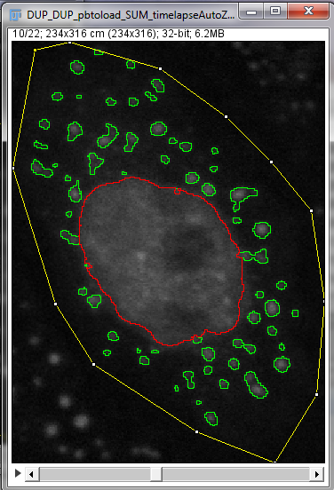
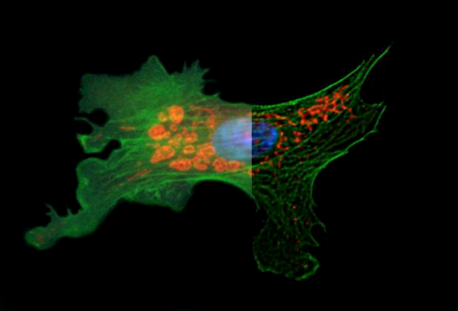
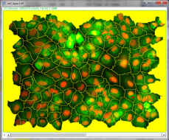
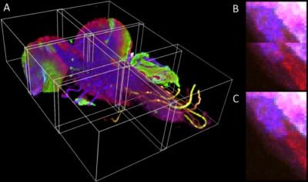
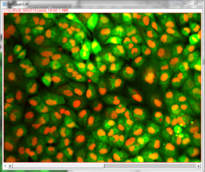
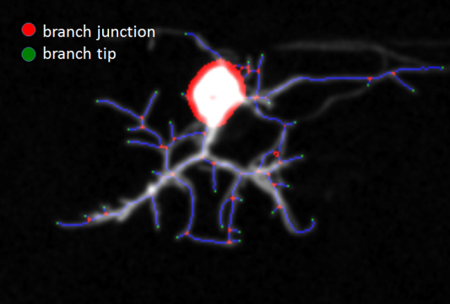
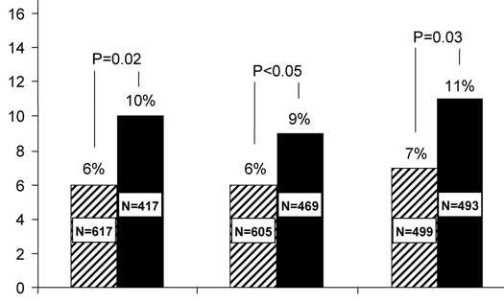
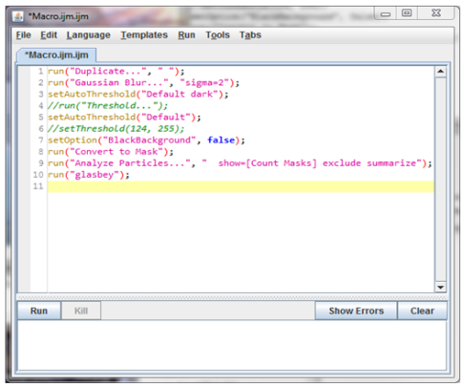
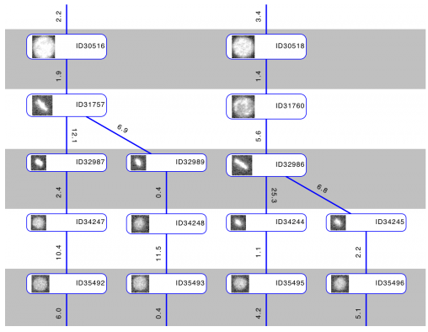
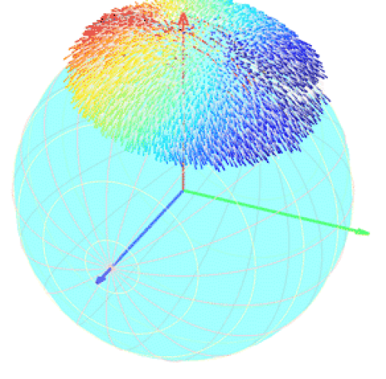
Bio-Image Analysis
Example steps
Image preparation
Find objects (segmentation)
Measurements
Automation

Slide 7
Bio-Image Analysis
Example steps
Image preparation
Find objects (segmentation)
Measurements
Goal of bio-image analysis:
Quantify image data objectively and reproducibly.
Automation

Slide 8
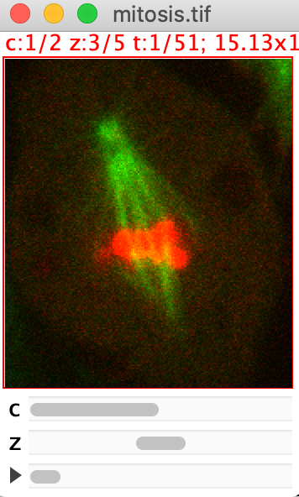
What is an image?

Slide 9
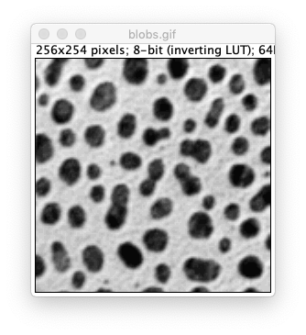

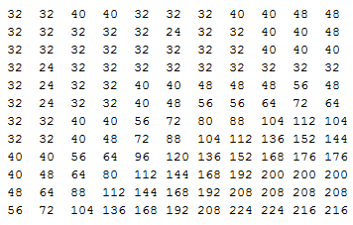
What is a digital image?
A digital image is a matrix with numbers.
A single pixel is the representation of one number of the matrix.
A pixel is not a little square but just the visualization of a single number.
Images are characterized by size, spatial resolution, intensity, bit-depth etc.
0
255

Slide 10
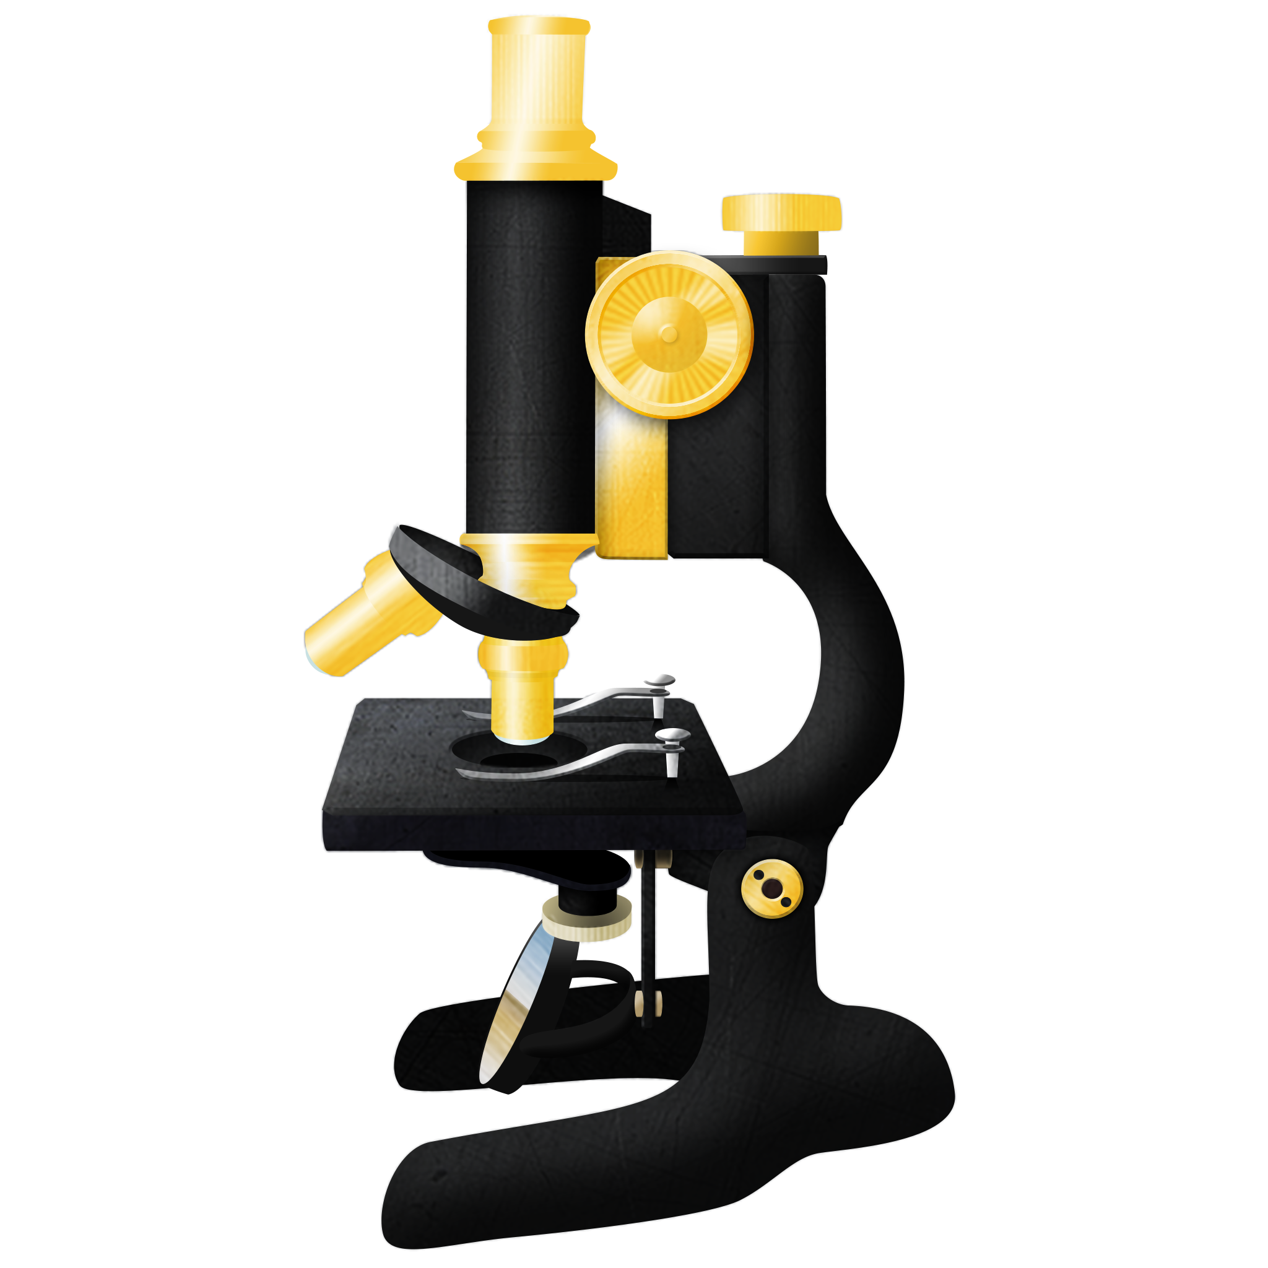
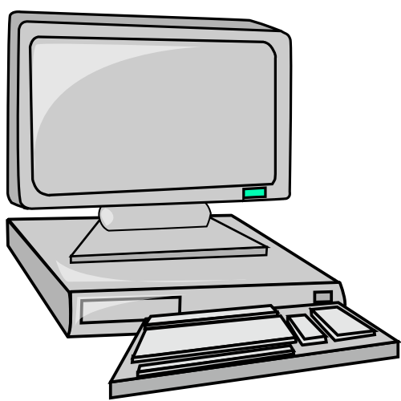
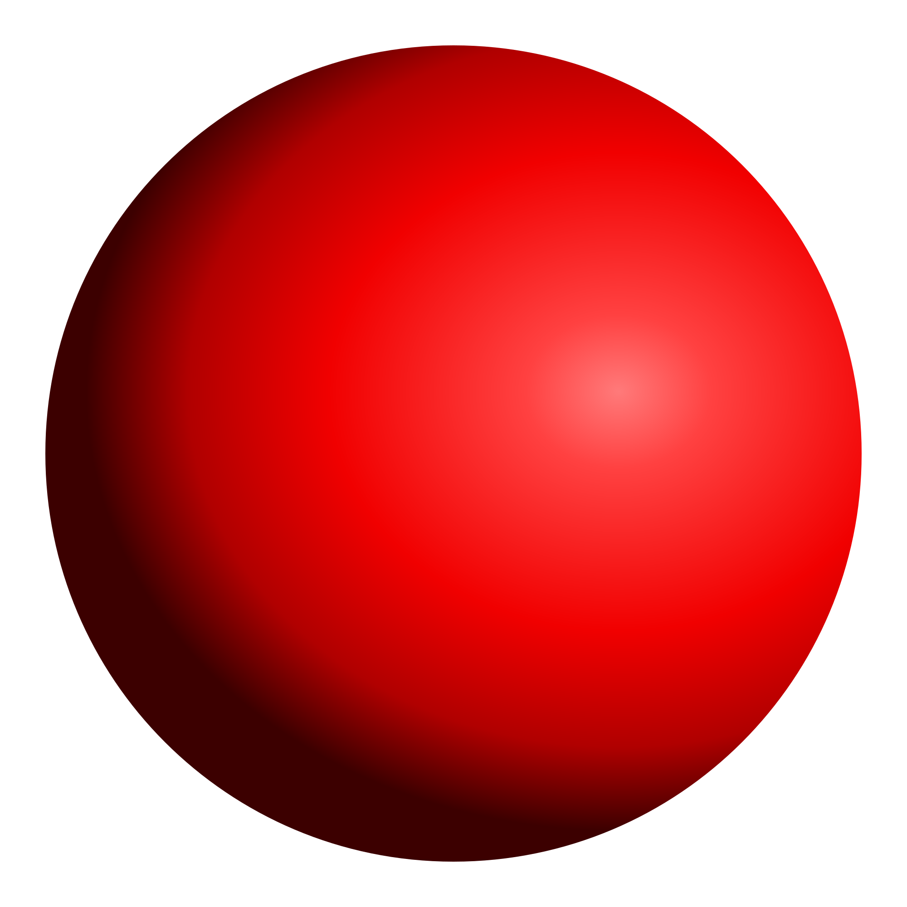
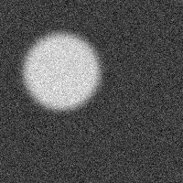
Image formation process
An image is a representation of a real object.
But the representation is imperfect:
Blur and noise degrade the image.
Digitization discretizes the intensity information.
…
real object
image acquisition
digital image
Notes:
Light source > Light > Lenses > Object > Camera > Read out camera (discrete px and values)
Other degradation: flatfield (inhomogeneous illumination) and darkfield (camera offset)

Slide 11

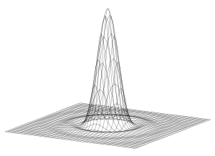


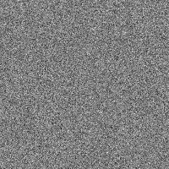
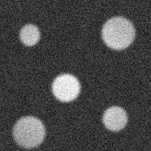
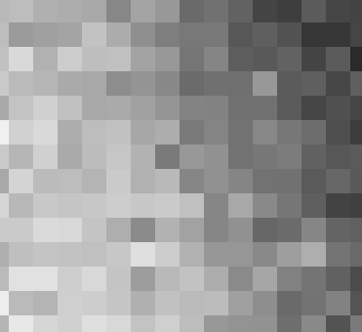
Image formation is not perfect.
General image degradation by blur and noise.
Inhomogeneous illumination (flatfield) and signal offset (darkfield)
Discretization of information
Blur is inherent to microscope optics.
PSF
theoretical image
observed image
*
+
=
flatfield
darkfield
observed image
PSF: https://en.wikipedia.org/wiki/Point_spread_function
Notes:
Darkfield: = signal that is measured at camera even though the shutter is closed (in particular widefield. For LSM we can adjust the offset)

Slide 12
Image dimensions
Images have up to 5 dimensions.
2D 3D (z-stack)
+ time + channels
A dataset can additionally consist of multiple tiles or views.

Slide 13
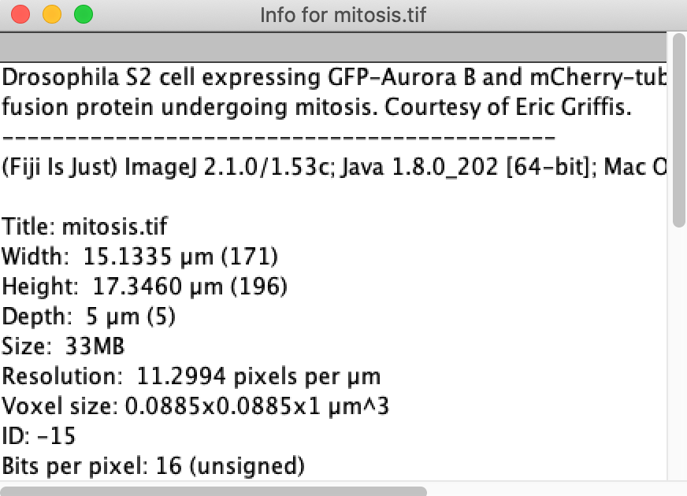
Image metadata
Metadata provides crucial additional information on the image.
Very import meta info: spatial scale.
Notes:
An image without meta info (how acquired, scale, …) is worth little.

Slide 14
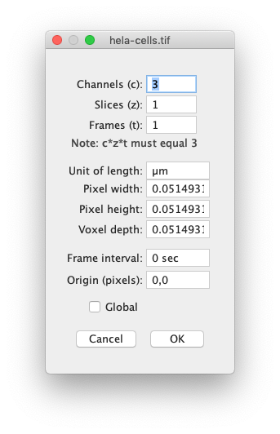
Pixel size (sampling)
Pixel size is the actual physical size of a pixel in an image.
On camera-based microscopes it is controlled by the magnification.
Width of 1 pixel = 0.05 um
Therefore: 1/0.05 = 20 pixels/ um

Slide 15
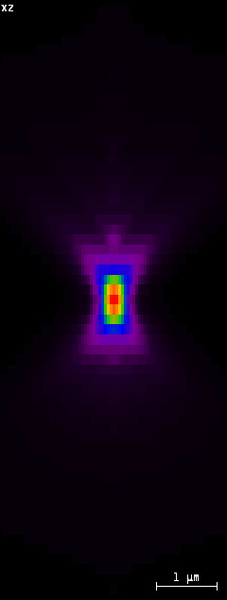
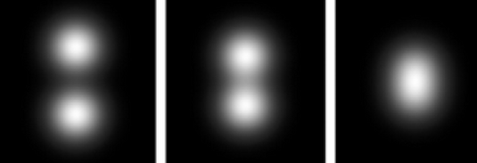
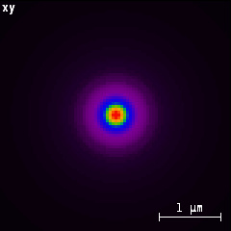
Optical resolution
Optical resolution is a property of the imaging system and determined by the type of microscope and objective.
It is defined as the minimum distance between two point objects to still be separable (see: PSF, Airy disc).
The optical resolution in axial direction (z) is lower than in lateral direction (x,y).
PSF from confocal microscope
PSF confocal: SVI Huygens Nyquist calculator: https://svi.nl/NyquistCalculator
Point objects: http://physwiki.apps01.yorku.ca/index.php?title=File:Fig15_airy.png
Notes:
Usually undersampling in z is the bigger issue. But if sampled high enough: consider deconvolution for resolution improvement

Slide 16
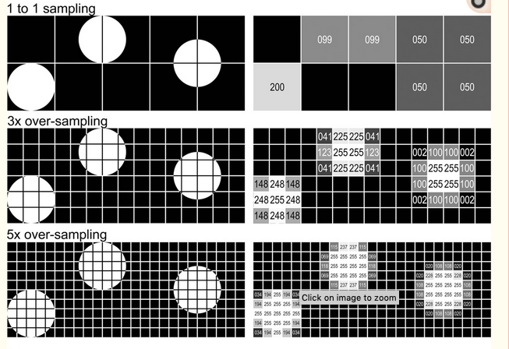
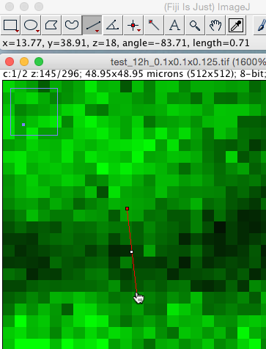
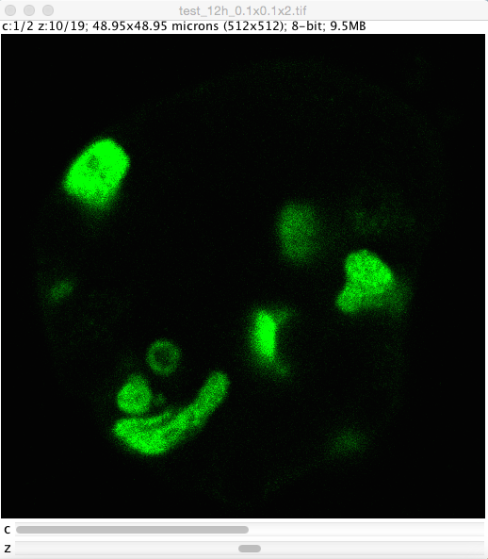
Nyquist–Shannon sampling theorem
Sampling frequency must be 2-3x larger than the smallest object you want to detect.
That means: at least(!) 3 pixel per and between objects (better more!).
Further reading: https://en.wikipedia.org/wiki/Nyquist-Shannon_sampling_theorem
To make use of the full optical resolution: Sample at 3x the optical resolution.
Nyquist calculator: https://svi.nl/NyquistCalculator
Image sources:
Elena Gromberg, Tanaka Group, CRTD Dresden
Cromey: Avoiding Twisted Pixels,

Slide 17
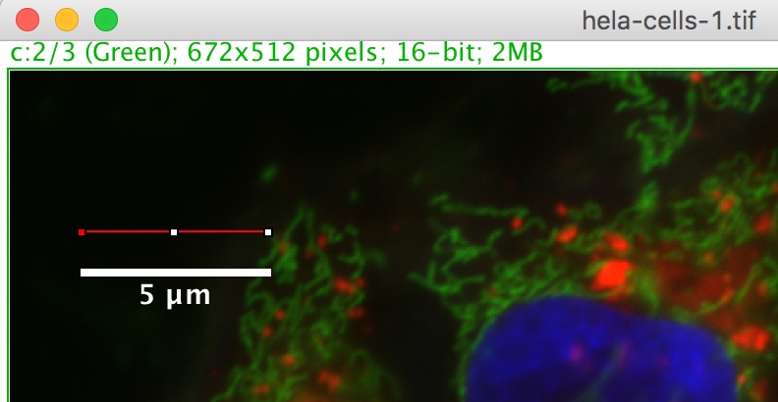
Quiz
The length of the red line drawn on the image is 95 pixels.
Based on the scale bar, what is the image’s pixel width?
0.5 µm
0.05 µm
0.01 µm

Slide 18



Bit-depth
The bit-depth n enumerates how many different intensity values are present in an image:
2^{n} grey values
In microscopy, images are usually stored as 8, 12 or 16-bit images.
1
2
3
4
5
6
7
8
1
2
16
Slide courtesy: Robert Haase

Slide 19



Lookup tables (LUTs)
The lookup table decides how the image is displayed on screen.
Applying a different lookup table doesn’t change the image. All pixel values stay the same, they just appear differently
Pixel value
Display color
Pixel value
Display color
Pixel value
Display color
0
1
2
…
255
0
1
2
…
255
0
1
2
…
255
Slide courtesy: Robert Haase

Slide 20




Lookup tables (LUTs)
Choose visualization of your color tables wisely!
Think of people with red/green blindness!
Default view
Red/green blind people see it like this
Replace red with magenta!
Slide courtesy: Robert Haase

Slide 21


Quiz
Which intensity does the marked pixel have?
0
0
64
64
128
128
192
192
256
256
0
64
128
192
Slide courtesy: Robert Haase

Slide 22


Image Histogram
All pixels of an image are counted and binned according to their value.
A histogram is a 1D summary of an image.
Background?
Object?
Number of pixels
Intensity

Slide 23


Image Histogram

Slide 24



Multichannel images
In microscopy, channels are usually acquired separately with a monochrome camera.
For a composite view, the channels are colored with different LUTs.
Coloring according to wavelength or for optimizing good contrast.

Slide 25





Color Images (RGB)
Color images are usually composed of RGB channels with 8bits per channel.
They are acquired with a color camera (e.g. photography).
Tip: Applications like MS Office cannot display multichannel images. Convert the image to RGB for export. This is non-reversible – work on an image copy!
Red Green Blue decomposition
RGB Image
Notes:
Alternative color decomposition: Alternative: HSV decomposition

Slide 26


Color spaces
Color images are often RGB – color is described by the 3 channels: red, green, blue.
Another common decomposition: CMYK
CIE commission established other color spaces which are closer to how colors are perceived by humans.
Most notably: CIELAB color space: L*a*b*
L (lightness), a (green/red), b (blue/yellow)
Perceptually uniform: Changes in L*a*b* values corresponds well to changes in human color perception (this is different for RGB).
Tip: Explore different color spaces.
Objects which are hard to distinguish with an algorithm in RGB space may be easier to distinguish in CIELAB space.
Image sources:
cube: wikipedia
CIELAB: XRite
Notes:
Monochrome camera (microscope) versus color camera -> color spaces matter for the latter
Color space conversion: think of it like a coordinate transform (but actually this is not quite true: non-absolute color space)
CIE: international commission on Illumination
RGB: corresponds to physical color difference – but two physically different colors may look quite uniform to a human

Slide 27

File formats
Common file formats for image saving.
tiff / tif
Very versatile (multichannel, zstacks, various bit depth, etc.).
Good with meta data.
Large file size
Use as default
hdf5 / h5
Specially developed for viewing and processing large data
png
Compressed but not lossy: small file sizes
Less powerful than tiff (metadata etc.)
Convenient for image export for presentations.
jpg / jpeg
Lossy compression.
Do not use this!
jpg artifacts

Slide 28
Tools for image analysis

Slide 29







Image Analysis Software
CellProfiler
MATLAB
ImageJ/Fiji
Ilastik
Imaris
Python
Huygens
Free/Commercial,
Customizable versus ease of use
Specific pipelines: slide analysis, HCS, neurons, 3D visualization,
large dataset
Notes:
Describe categories of software available

Slide 30


Introduction to FIJI Image characteristics and visualization

Slide 31
Image Analysis Software: FIJI
Swiss army knife of biological images
Multiplatform
Good user/developer base
Versatile data reader
Wide range of plugins supported
Multiple level of interactions
Many tools
Macro/scripting
High level image analysis API

Slide 32

FIJI: Menu and Interface
Tool bar
Status bar
Menu

Slide 33

Command Finder
Press the “L” key and start typing in the search bar.
It is a very powerful tool – and helps navigating through confusing menus.
Notes:
Any color can be chosen for the channel
Functional meaning of the protein

Slide 34



Opening images with FIJI
Methods:
Drag and drop
File > Open > …
File > Import > …
Bio-formats support
Can open proprietary
file formats (.czi, .lsm, …)
Image sequence
Tip:
You can also drag Results tables, Scripts etc to Fiji to open them.

Slide 35


Image Interface
Zoom factor
(use +/- keys)
Image bit-depth
Image size in physical units (and in pixels)
Dataset positions
c = channel
z = slice
t = time frame

Slide 36


Image Navigation
Press “+” or “-” to zoom in and out.
Point the region to zoom in with the mouse
Press “space” and left click on the image to pan it

Slide 37



Image meta-data
Image > Show Info…
Image > Properties…

Slide 38


Spatial scale bar
A scale bar is important when presenting images.
“Is an object in the image 50um or 1000um?”: Hard to tell without scale bar.
Analyze > Tools > Scale Bar …

Slide 39

Viewing pixel values
Value at current mouse position
Values along a line selection Analyze > Plot Profile …

Slide 40


Image histogram
Analyze > Histogram
Notes:
Just for reference for this image: AuPb was blurred previously with gaussian, sigma=1

Slide 41




Brightness & Contrast
Adjusting brightness & contrast changes the display range (windowing) of the image.
Image > Adjust > Brightness/Contrast… or Cmd/Ctrl+Shift+C
0
85
255

Slide 42

Brightness & Contrast
Adjusting the display range does not change the pixel values - it is just a visualization.
Careful: “Apply” changes the pixel values and remaps them to the current display range – this is irreversible!
Don’t use this. Unless you need it for visualization – then use with care.
saturation
Notes:
Can you on histogram: saturated + zero pixels + gaps in intensity

Slide 43







Multichannel images
Composite image: visualize image with multiple channels simultaneously
In FIJI, Image> Color> Make Composite, Image> Color> Channels tool.. for more
Image> Color > Split channels

Slide 44


RGB vs composite images
Convert RGB to Composite: Image > Color > Make Composite

Slide 45


Lookup tables
Image > Lookup Tables
HiLo
(shows saturation)

Slide 46

Color calibration Bar
Analyze > Tools > Calibration Bar…
Recommended when using non-standard LUT (Fire, Spectrum..)
Adds a ramp to show which color represents which gray-value.

Slide 47


Setting Fiji up properly
Common issues to better fix right away:
Images should have white objects on black background:
Go to Fiji> Process> Binary> Options
Set Black background = True
Allocate maximum memory to be used by FIJI
Go to Fiji> Edit > Options > Memory and Threads
Do not use command launcher for setting this

Slide 48


Fiji Update Sites
The Fiji Updater updater lets you subscribe to many plugins and extends your toolbox.
It checks automatically for updates and helps keeping Fiji up-to-date.
Fiji: Help > Update ….
“Apply changes” to update, then restart Fiji.
Update Fiji frequently.
If you worry about reproducibility: First create a copy of Fiji and store it together with the analysis.

Slide 49

Adding an update site
Run the updater explicitly by going to Help> Update…
Select Manage Update Sites to bring up a window of all the updates sites.
Select the ones you want and click on Close to add these updates.
Choosing Add update site allows you to add a website manually.
Click “Apply changes” to update, then restart Fiji.
See also: https://imagej.net/Following_an_update_site
Notes:
Do we also need to show advanced mode?

Slide 50


Image.sc Forum: Getting Help
https://forum.image.sc/
Very active forum on image analysis
For all user levels
For conceptual questions, technical issues, announcements etc.
Often you get help very quickly.
Tips:
Be nice – the people who help you are volunteering.
If you know an answer: help others.

Slide 51









Demo
Used data for demo:
AuPbSn40.tif
hela-cells.tif
Clown.jpg
Image properties, pixel values, LUTs, command finder, bit depth, channel control, brightness & contrast, …

Slide 52
Quiz
In Fiji, open the Fly Brain image (File > Open Samples > Fly Brain (1MB)) and display its metadata window and properties window.
What is the height of this image in microns?
What is the pixel width?
256
684.93
2.67 um
3.94 um

Slide 53

Bit depth: Converting the image type
Image type conversion can be irreversible. Information is then lost and cannot be recovered.
Examples:
16-bit -> 8-bit: Irreversible!
8 bit -> 16 bit: No problem. Higher bit-depth is always ok.
Multichannel composite -> RGB: usually irreversible!
Never do lossy conversion for quantitative analysis. Only use for visualization (of a copy of) the image.

Slide 54
Bit-depth Conversion: 16bit -> 8bit
Scenario:
Images were acquired at 16bit to maximize the recorded information.
But for a presentation in PowerPoint you need an 8bit version of it – otherwise it would look black.
Why is this not trivial?
16bit: possible values: [0, 65535]
8bit: possible values: [0,255]
Different options for mapping the two ranges:
0
65535
0
65535
0
65535
0
255
0
255
0
255
no scaling
scale full range
custom scaling (adjusted to image properties)

Slide 55



Bit-depth Conversion: 16bit -> 8bit
In Fiji: Image > Type > 8-bit
“Scale when converting” in Edit > Options > Conversions should usually be checked.
But Caution! The min-max values for scaling are taken automatically from the min–max in the Brightness & Contrast window.
For converting multiple images of an experiment: Always set min-max to the same value before conversion.

Slide 56

Exercise
Prepare image for presentation
Open the image cell_layer2.tif
Split channels
Merge channel 1 and 3
Update channel 1 LUT to magenta
Adapt contrast of each channel
Convert type to RGB
Add a scale bar
Save as Tiff
Try to load in a ppt/keynote
Notes:
Scale bar should not be visible : Flatten again = convert to RGB

Slide 57


Exercise
Bit-depth conversion
Open zfish_retina.tif
Extract first channel, set LUT to gray.
What is the bit depth?
Measure a profile along a line.
For every conversion work on a separate duplicate.
Always measure the profile after conversion.
(A) Convert to 8 bit (Image > Type > 8-bit).
(B) First change the Brightness & Contrast display. Then convert to 8-bit.
(C) Uncheck scaling temporarily. Then convert to 8-bit.
Edit > Options > Conversions
Turn scaling on again.

Slide 58




Summary
Grey level image
d
Image
Pixel Size
Pixel value, Bit depth
Histogram
Visualisation
RGB, Composite Images
LUTs
B&C
Channels tool

Slide 59

ROI & Measurements

Slide 60

ROI: Region of Interest
Region tools:
Rectangle, rounded rectangle
Oval, orientable ellipse, brush tool
Polygon, free form, Wand tool
Line tools:
Straight, segmented, free
Point tools:
Point, Multi-Point
Interactively edit ROIs
Double click to see the options

Slide 61





ROI: Region of Interest
There are more tools in the toolbar than visible
Use right-click and double-click to uncover them

Slide 62







ROI: Region of Interest
draw a rectangle
using the rectangle tool
draw a circle
using the circle tool
add objects to the ROI
by holding SHIFT
unite objects to the ROI
by holding SHIFT
subtract objects to the
ROI by holding ALT
move the ROI
by clicking inside and move the mouse
delete the ROI
by clicking outside
Recover the last ROI
by using menu Edit > Selection > Restore Selection (SHIFT+CMD+E)

Slide 63




ROI Measure Workflow
Open an image
Select a tool and draw ROI
Select Table
File > SaveAs
Export data for analysis
Analyze > Set measurements
Analyze > Measure
Creates results table

Slide 64







The ROI Manager
In Fiji, Analyze> Tools > ROI Manager…
Helps in storing and dealing with multiple ROIs
Press key “T”

Slide 65



The ROI Manager
Visualize, label and measure ROIs

Slide 66

The ROI Manager
Additional functions available:
Combine multiple ROIs (OR)
Split ROIs (Split)
Save
…

Slide 67
Quiz 4
You can rename a ROI
You cannot change the ROI outline color
You can save a ROI as a file
Open the ROI manager Analyze> Tools > ROI Manager… and check the functions.
Now answer TRUE or FALSE to the statements about ROI Manager
True
False
True
False
True
False

Slide 68


Image Overlay
Non-destructive visualization of outlines.
Adds ROIs to an extra image layer which is for display only and can be toggled on/off.
In FIJI, draw a ROI, then: Image> Overlay>Add Selection.
To create an image for PowerPoint: Burn the overlay into the image:
Image > Overlay > Flatten
Careful! This changes the images and the outline cannot be removed again!
Image from: http://blogs.qub.ac.uk/ccbg/files/2014/05/2014-05_Analyzing_fluorescence_microscopy_images.pdf
Notes:
The “show all” in ROI manager creates implicitely an Overlay.

Slide 69
Demo
Used data for demo:
FluroescentCells.tif
ROIs, ROI manager, measure, set measurements, overlay, …

Slide 70

Exercise
Measure embryo average size
Open embryos.tif
Use Line ROI to measure diameter of e.g. 5 embryos
Save the result table, then clear it.
Draw the outline of an embryo to the ROI manager. Repeat for a few embryos.
Measure area and intensity.
Add an overlay to the image and save it
Either ROI by ROI (“add Selection”)
Or “Roi Manager > Show All” (Creates an overlay).
Flatten image and save it too
Open image in IJ and PPT

Slide 71

Summary
ROI manager
Measure pipeline
Overlay

Slide 72

Counting Objects

Slide 73


Finding Objects
Object detection
Point/Box per object
Use cases:
Counting
Tracking spots
Object segmentation
Outline per object
Uses cases:
Shape quantification
Spatial relation of objects
Notes:
Detection is easier
Spatial relation between objects: e.g. neighbors, what is inside/outside of cells

Slide 74


Object detection
There are multiple ways for detecting objects. Examples:
Intensity maxima
Spots/Blobs
Template matching
Template matching: https://scikit-image.org/docs/dev/auto_examples/features_detection/plot_template.html
Notes:
Maxima: single brightest point
Spots/Blobs: searches for spots of specified size

Slide 75


Image maxima: counting objects
An image can be imagined as a landscape of hills and valleys
Counting objects: detect how many peaks or hills are there in the image!

Slide 76




Counting objects in Fiji
In FIJI, use Process > Find Maxima.. to detect peaks in an image
Easy way to do a quick counting of objects
Pipeline: Open image, find maxima, measure

Slide 77

Find maxima menu
How high is the peak value from its base (~dynamic range)
Include/exclude maxima at the edge of the image
Are objects on light or dark bg
Various output options
Preview the detected points
More info (on “strict” option): https://forum.image.sc/t/new-maxima-finder-menu-in-fiji/25504/9
Photo: http://fwp.mt.gov/mtoutdoors/HTML/articles/2013/peakbagging.htm#.V-P1NvArIdU

Slide 78







Find maxima menu
Possible outputs from maxima finder

Slide 79
DEMO
Used data:
Spot_detection.tiff

Slide 80




Other tools: ComDet
Fiji plugin for finding “roundish” objects in image of specified size
Spots, vesicles, droplets, dots, etc.
Features:
Preview function
Option to detect in a ROI
Option to do colocalization (shows up when you open 2-ch image)
Results table
Plugins > ComDet Detect Particles
https://github.com/ekatrukha/ComDet/wiki/How-to-use-plugin-%28Text-Tutorial%29

Slide 81

Exercise
Count spots
Open nuclei_transcripts_zebrafish.tif
Split channels and work on channel 1. Crop it.
Use Maxima Finder menu to count number of spots in the image
List their coordinates
Vary the prominence, strict and exclude the edge parameters and identify the changes in maxima detection

Slide 82



Summary
Detection vs Segmentation
Counting: Maxima detection
FIJI Find Maxima

